Slide 1
Boosting Algorithms
Boosting is an ensemble method of converting weak learners into strong learners. Weak and strong refer to a measure how correlated are the learners to the actual target variable.
In boosting, each training sample are used to train one unit of decision tree and picked with replacement over-weighted data.
The trees will learn from predecessors and updates the residuals error.

Slide 2
Types of Boosting Algorithms
Ada Boost
XG Boost
LG Boost

Slide 3
Ada Boost
AdaBoost was the first practical boosting algorithm, and remains one of the most widely used and studied, with applications in numerous fields. AdaBoost algorithm works on changes the sample distribution by modifying weight data points for each iteration.

Slide 4
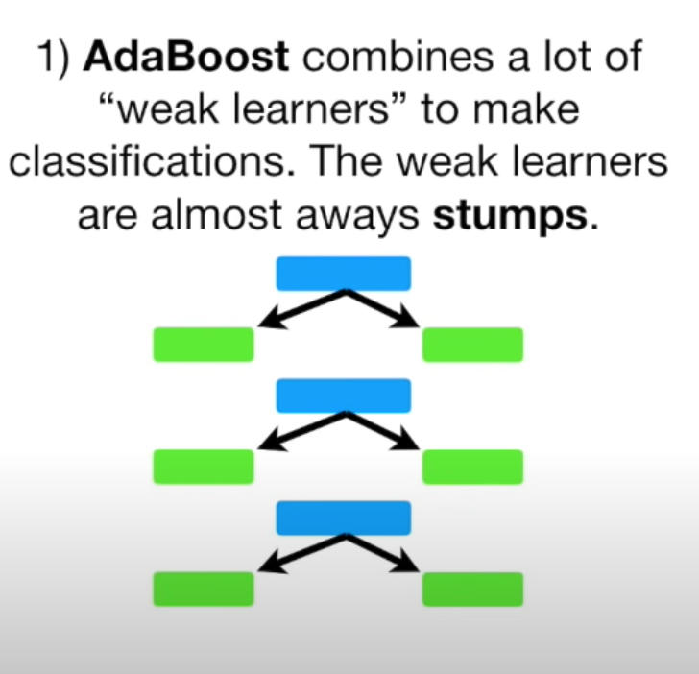
AdaBoost

Slide 5
AdaBoost use trees:
In AdaBoost with decision trees, the technique works by iteratively training a sequence of decision trees on weighted versions of the training data. At each iteration, the weights of misclassified instances are increased, so subsequent trees focus more on these instances

Slide 6
XGBoost (Extreme Gradient Boosting)
XGBoost is an optimized version of GBM, utilizing a more regularized model to control overfitting and enabling parallel computing.
LightGBM:
LightGBM is another gradient boosting framework that achieves high performance with lower memory usage. It splits the tree leaf-wise rather than level-wise.

Slide 7
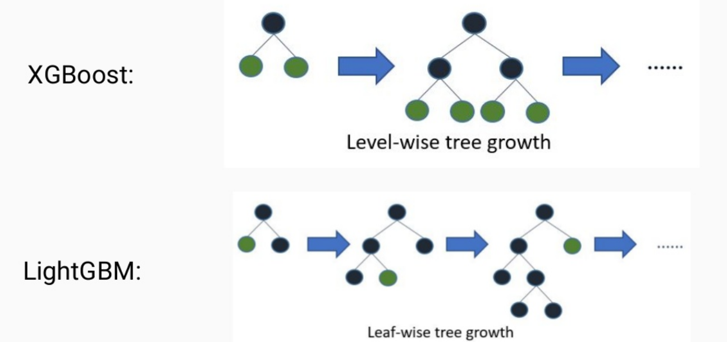
LightGBM and XGBoost

Slide 8
LightGBM grows trees leaf-wise (best-first). It will choose the leaf with max delta loss to grow. Holding #leaf fixed, leaf-wise algorithms tend to achieve lower loss than level-wise algorithms. Leaf-wise may cause over-fitting when #data is small, so LightGBM includes the max_depth parameter to limit tree depth.
The level-wise strategy grows the tree level by level. In this strategy, each node splits the data prioritizing the nodes closer to the tree root. The leaf-wise strategy grows the tree by splitting the data at the nodes with the highest loss change.

Slide 9
Thank You

